Slide 1

Designing of IoT Solutions
Case studies
Rashma.B.M
Department of Computer Science Engineering

Slide 2

Designing of IoT Solutions
Case study :Smart city
Rashma.B.M
Department of Computer Science Engineering

Slide 3
Designing IoT Solutions
Issues with implementing IoT in large scale
City issues are typically large-scale.
They require collection of large amounts of diverse data sets in real time
data from traffic sensors, traffic cameras, parking sensors, and more has to be collected and analyzed in real time so that decision making can be optimized around signal timing, rerouting, and so on. Each smart city needs a tailored and structured computing model that allows distributed processing of data with the level of resiliency, scale, speed, and mobility required to efficiently and effectively deliver the value that the data being generated can create when properly processed across the network.

Slide 4
Designing IoT Solutions
Issues with implementing IoT in large scale
All these requirements pose technological challenges, including the following:
How do you collect the data?
What are the various sources of data, including hardware endpoints and software?
How do you make sure that any data collection devices, such as sensors, can be maintained without high costs?
Where do you analyze the data?
What data do you carry back to the cloud, and what data do you analyze locally?
What kind of network connectivity is best suited for each type of data to collect?
What kind of power availability and other infrastructure, such as storage, is required?
How do you aggregate data from different sources to create a unified view?
How do you publish the data and make it available for applications to consume?
How do you make the end analysis available to specialized smart city personnel, such as traffic operators, parking enforcement officers, street lighting operators, and so on at their logical decision points?
How do you present the long-term analysis to city planners?

Slide 5
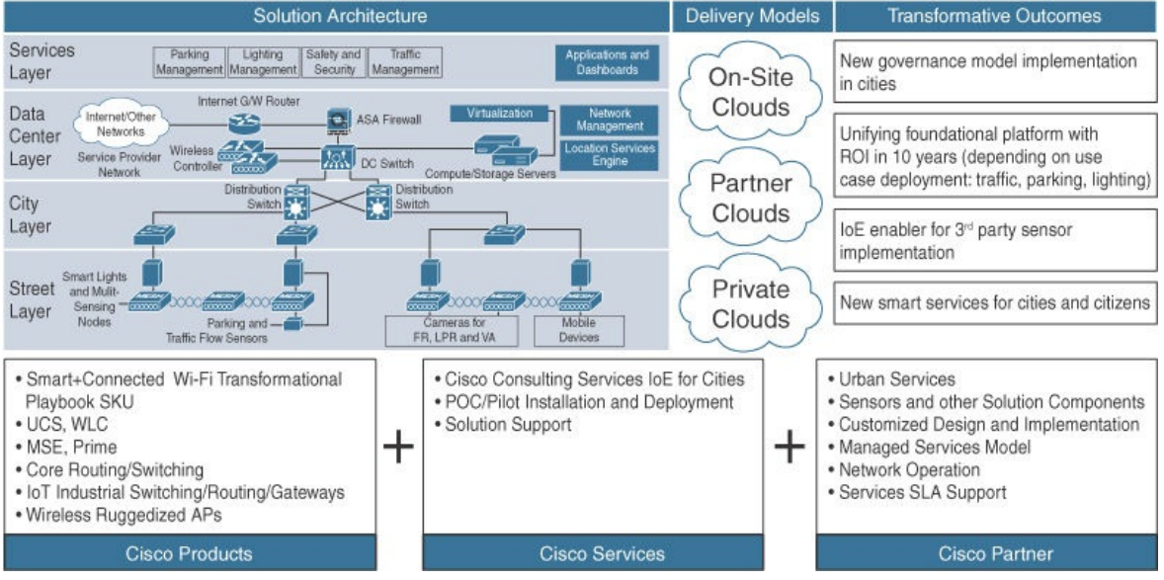
Designing IoT Solutions
Smart city architecture- proposed by cisco

Slide 6
THANK YOU
Rashma.B.M
Department of Computer Science Engineering
rashmabm@pes.edu

